Slide 1
Module-5
Transport Layer
Dr. R. Prashanth

Slide 2
Introduction
The transport Layer is the second layer in the TCP/IP model and the fourth layer in the OSI model. It is an end-to-end layer used to deliver messages to a host.
Transmission Control Protocol (TCP) and User Datagram Protocol (UDP) both are protocols of the Transport Layer.
TCP is a connection-oriented protocol where as UDP is a part of the Internet Protocol suite, referred to as the UDP/IP suite.
Unlike TCP, it is an unreliable and connectionless protocol.

Slide 3
Difference between Connection-oriented and Connection-less Services
Both Connection-oriented service and Connection-less service are used for the connection establishment between two or more two devices. These types of services are offered by the network layer.
Connection-oriented service is related to the telephone system. It includes connection establishment and connection termination. In a connection-oriented service, the Handshake method is used to establish the connection between sender and receiver.
Connection-less service is related to the postal system. It does not include any connection establishment and connection termination. Connection-less Service does not give a guarantee of reliability. In this, Packets do not follow the same path to reach their destination.

Slide 4
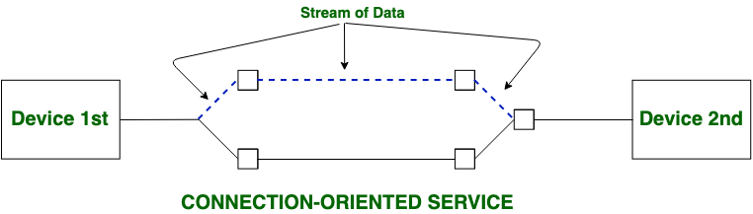
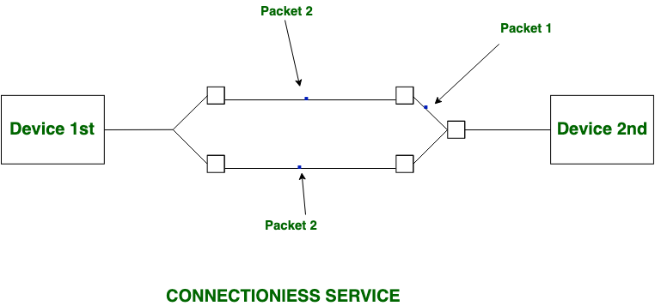

Slide 5
Transmission Control Protocol (TCP)
TCP (Transmission Control Protocol) is one of the main protocols of the Internet protocol suite. It lies between the Application and Network Layers which are used in providing reliable delivery services.
It is a connection-oriented protocol for communications that helps in the exchange of messages between different devices over a network.
The Internet Protocol (IP), which establishes the technique for sending data packets between computers, works with TCP.

Slide 6
TCP is short for Transmission Control Protocol.
It is a transport layer protocol.
It has been designed to send data packets over the Internet.
It establishes a reliable end to end connection before sending any data.

Slide 7
TCP is a connection oriented protocol.
This is because-
TCP establishes an end to end connection between the source and destination.
The connection is established before exchanging the data.
The connection is maintained until the application programs at each end finishes exchanging the data.

Slide 8
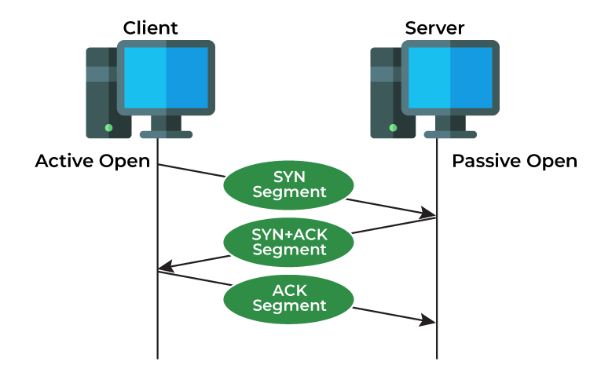
Fig. Handshake method

Slide 9
Message | Description
Syn | Used to initiate and establish a connection. It also helps you to synchronize sequence numbers between devices.
ACK | Helps to confirm to the other side that it has received the SYN.
SYN-ACK | SYN message from local device and ACK of the earlier packet.
FIN | Used to terminate a connection.

Slide 10
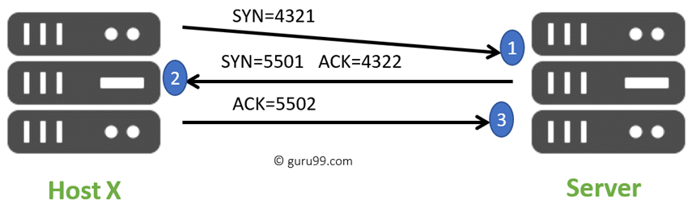
TCP Three-Way Handshake Process

Slide 11
Here is a simple example of the three-way handshake process that is consists of three steps:
Host X begins the connection by sending the TCP SYN packet to its host destination. The packets contain a random sequence number (For example, 4321) that indicates the beginning of the sequence numbers for data that the Host X should transmit.
After that, the Server will receive the packet, and it responds with its sequence number. It’s response also includes the acknowledgment number, that is Host X’s sequence number incremented with 1 (Here, it is 4322).
Host X responds to the Server by sending the acknowledgment number that is mostly server’s sequence number that is incremented by 1.

Slide 12
TCP is a reliable protocol.
This is because-
It guarantees the delivery of data packets to its correct destination.
After receiving the data packet, receiver sends an acknowledgement to the sender.
It tells the sender whether data packet has reached its destination safely or not.
TCP employs retransmission to compensate for packet loss.

Slide 13
TCP handles both congestion and flow control.
TCP handles congestion and flow control by controlling the window size.
TCP ensures in-order delivery.
TCP ensures that the data packets get deliver to the destination in the same order they are sent by the sender.
Sequence Numbers are used to coordinate which data has been transmitted and received.

Slide 14
TCP connections are full duplex.
TCP connection allows to send data in both the directions at the same time.
So, TCP connections are Full Duplex.
TCP is a byte stream protocol.
Application layer sends data to the transport layer without any limitation.
TCP divides the data into chunks where each chunk is a collection of bytes.
Then, it creates a TCP segment by adding TCP header to the data chunk.
TCP segment = TCP header + Data chunk.

Slide 15
TCP provides error checking & recovery mechanism.
TCP provides error checking and recovery using three simple techniques-
Checksum
Acknowledgement
Retransmission

Slide 16
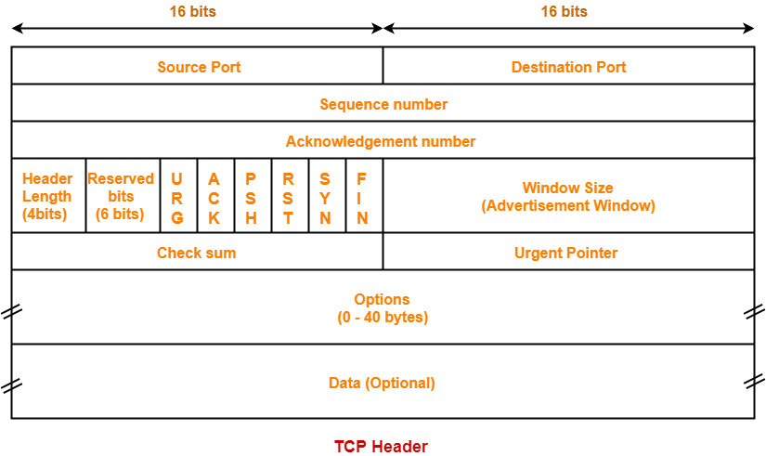

Slide 17
Source Port-
Source Port is a 16 bit field.
It identifies the port of the sending application.
Destination Port-
Destination Port is a 16 bit field.
It identifies the port of the receiving application.

Slide 18
Acknowledgement Number
Acknowledgment number is a 32 bit field.
It contains sequence number of the data byte that receiver expects to receive next from the sender.
It is always sequence number of the last received data byte incremented by 1.
Header Length-
Header length is a 4 bit field.
It contains the length of TCP header.
It helps in knowing from where the actual data begins.

Slide 19
Reserved Bits
The 6 bits are reserved.
These bits are not used.
URG Bit
URG bit is used to treat certain data on an urgent basis.
When URG bit is set to 1,
It indicates the receiver that certain amount of data within the current segment is urgent.
Receiver forwards urgent data to the receiving application on a separate channel.

Slide 20
ACK
When ACK bit is set to 1, it indicates that acknowledgement number contained in the TCP header is valid.
For all TCP segments except request segment, ACK bit is set to 1.
PSH Bit
PSH bit is used to push the entire buffer immediately to the receiving application.
RST Bit
RST bit is used to reset the TCP connection.

Slide 21
Limitations of TCP
It is slower than UDP and it takes more bandwidth.
Slower upon starting of transfer of a file.
Not suitable for LAN and PAN Networks.
It does not have a multicast or broadcast category.
It does not load the whole page if a single data of the page is missing.

Slide 22
User Datagram Protocol (UDP)
User Datagram Protocol (UDP) is a Transport Layer protocol. UDP is a part of the Internet Protocol suite, referred to as the UDP/IP suite.
Unlike TCP, it is an unreliable and connectionless protocol. So, there is no need to establish a connection before data transfer.
The UDP helps to establish low-latency and loss-tolerating connections establish over the network. The UDP enables process-to-process communication.

Slide 23
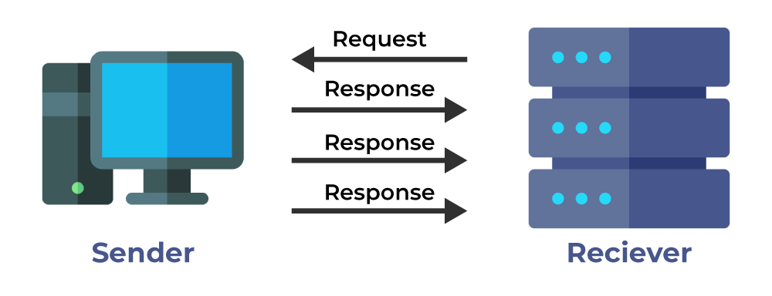

Slide 24
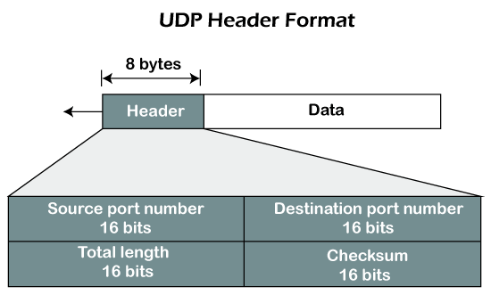
UDP Header format

Slide 25
The UDP header contains four fields:
Source port number: It is 16-bit information that identifies which port is going t send the packet.
Destination port number: It identifies which port is going to accept the information. It is 16-bit information which is used to identify application-level service on the destination machine.
Length: It is 16-bit field that specifies the entire length of the UDP packet that includes the header also. The minimum value would be 8-byte as the size of the header is 8 bytes.
Checksum: It is a 16-bits field, and it is an optional field. This checksum field checks whether the information is accurate or not as there is the possibility that the information can be corrupted while transmission. It is an optional field, which means that it depends upon the application, whether it wants to write the checksum or not. If it does not want to write the checksum, then all the 16 bits are zero; otherwise, it writes the checksum. In UDP, the checksum field is applied to the entire packet, i.e., header as well as data part whereas, in IP, the checksum field is applied to only the header field.

Slide 26
Limitations
It provides an unreliable connection delivery service. It does not provide any services of IP except that it provides process-to-process communication.
The UDP message can be lost, delayed, duplicated, or can be out of order.
It does not provide a reliable transport delivery service. It does not provide any acknowledgment or flow control mechanism. However, it does provide error control to some extent.

Slide 27
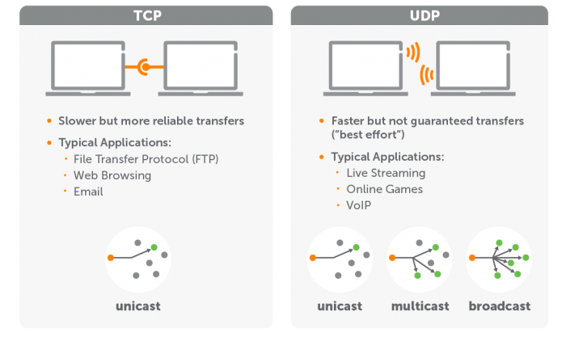
Difference between TCP and UDP

Slide 28
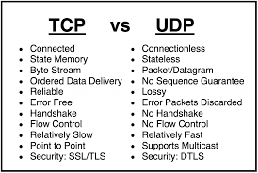

Slide 29
Flow Control vs Congestion Control

Slide 30
Flow Control
Flow control is a technique used to regulate the flow of data between different nodes in a network.
It is a process of managing the rate of data transmission between two nodes to prevent a fast sender from overwhelming a slow receiver
It ensures that a sender does not overwhelm a receiver with too much data too quickly.
The goal of flow control is to prevent buffer overflow, which can lead to dropped packets and poor network performance.
Prevents buffer overflow: Flow control prevents buffer overflow by regulating the rate at which data is sent from the sender to the receiver.

Slide 31
Introduction
Flow Control and Congestion Control are traffic controlling methods for different situations.
The main difference between flow control and congestion control is that, In flow control, rate of traffic received from a sender can be controlled by a receiver.
On the other hand, In congestion control, rate of traffic from sender to the network is controlled.

Slide 32
Receiver advertises a window rwnd (receiver window) with each acknowledgment.
Window:
Closed (by sender) when data is sent and acknowledgment
Opened (by receiver) when data is read
The size of this window can be the performance limit

Slide 33
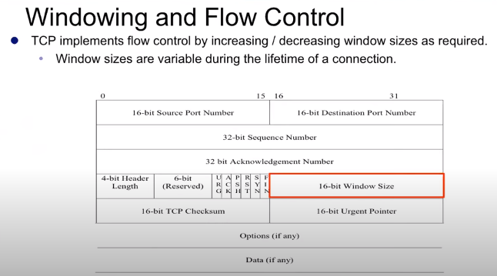
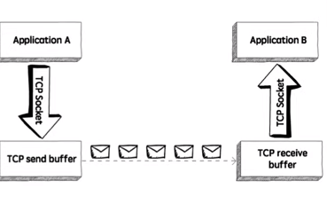

Slide 34
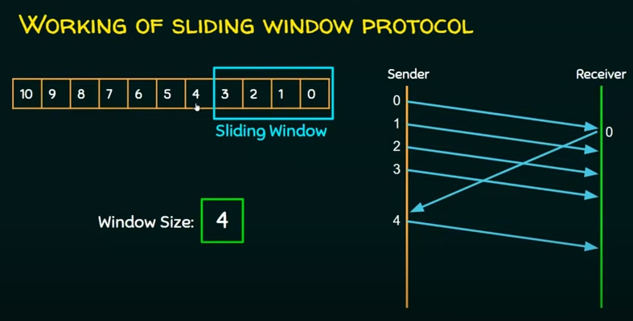

Slide 35
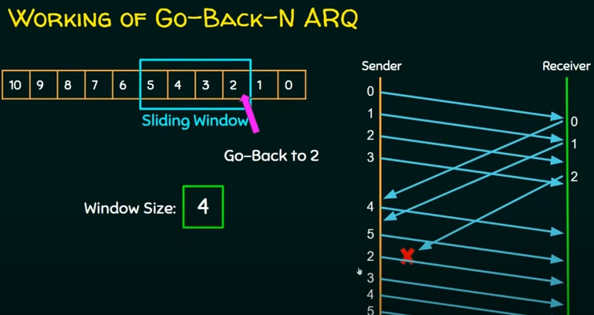

Slide 36
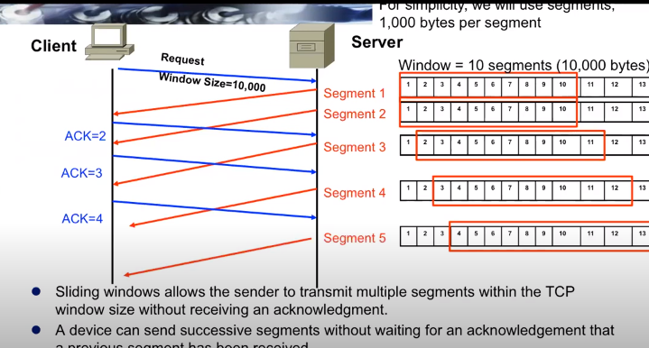

Slide 37
Congestion Control:
Congestion control is a technique used to prevent congestion in a network.
Congestion occurs when too much data is being sent over a network, and the network becomes overloaded, leading to dropped packets and poor network performance.
When a connection is established, a suitable window size has to be chosen.
The receiver specify a window based on buffer size. If the sender stick to this window size, problems will not occur due to buffer over flow at the receiving end, but they may still occur due to internal congestion within the network.

Slide 38
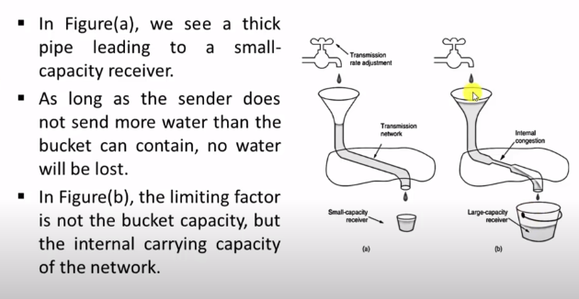

Slide 39
Congestion control prevents network congestion by regulating the rate at which data is sent from the sender to the receiver.
Efficient use of network resources: Congestion control helps in efficient use of network resources by reducing the number of lost packets and retransmissions

Slide 40
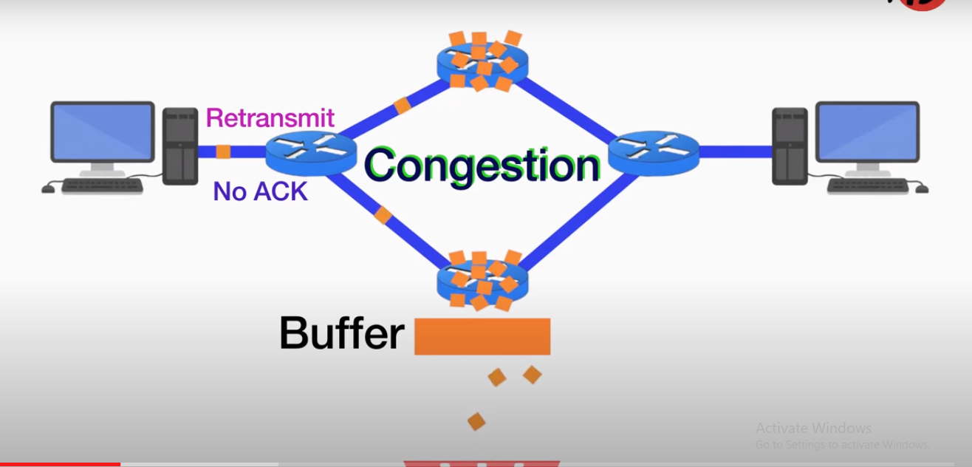

Slide 41
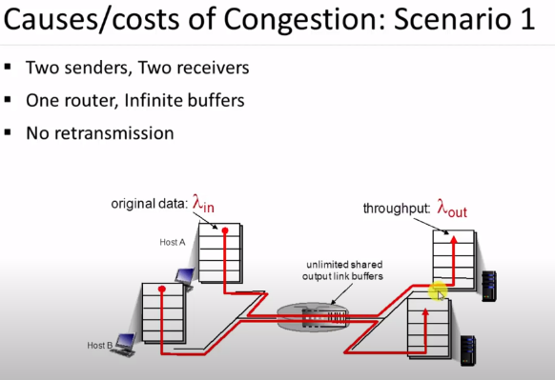
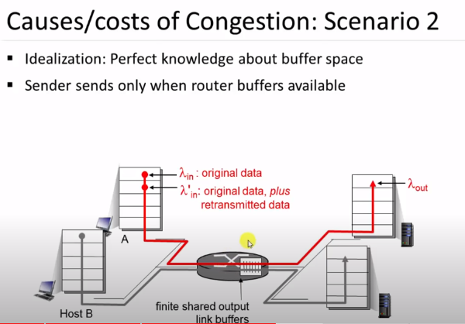

Slide 42
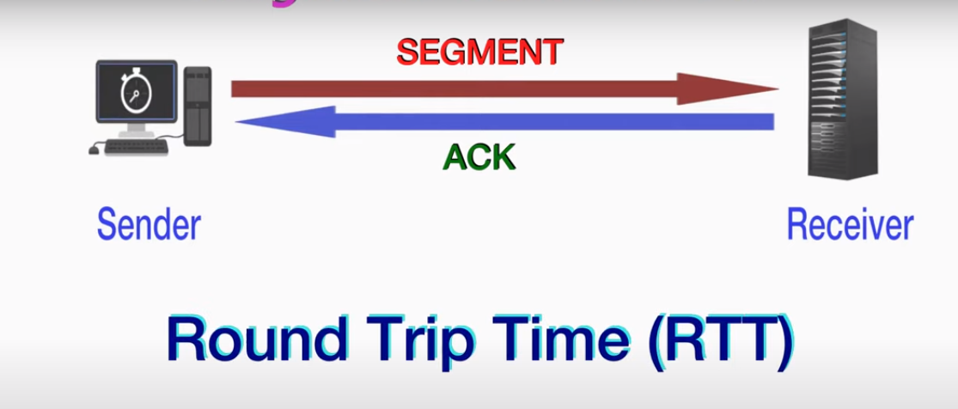
RTT

Slide 43
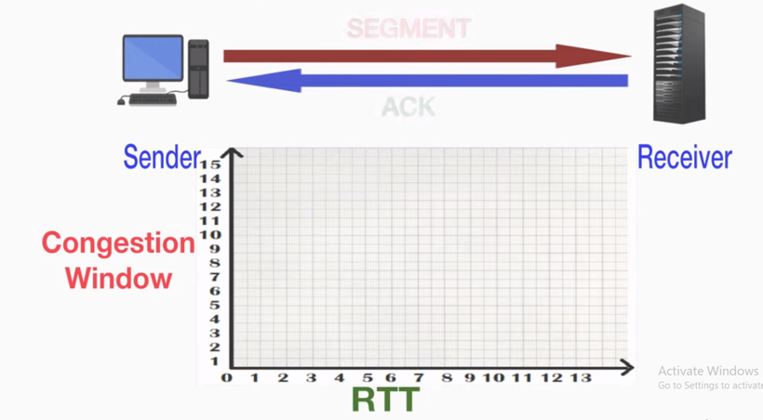
To control the congestion TCP uses Additive Increase Multiplicative Decrease (AIMD)

Slide 48
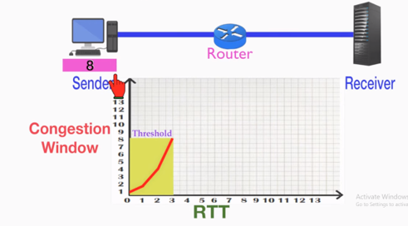
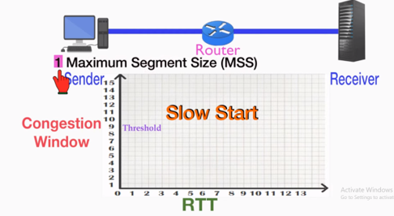
Phase 1: Slow start
Exponentially, slow start cannot continue

Slide 49
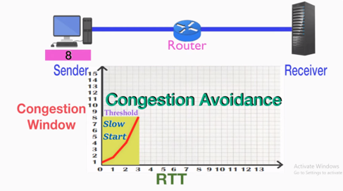
Phase 2: Congestion Avoidance
Congestion Avoidance: Increase the congestion window additively (add +1)

Slide 50
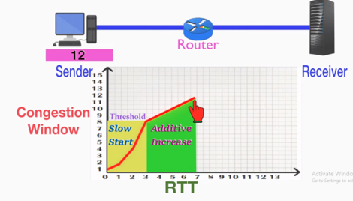

Slide 51
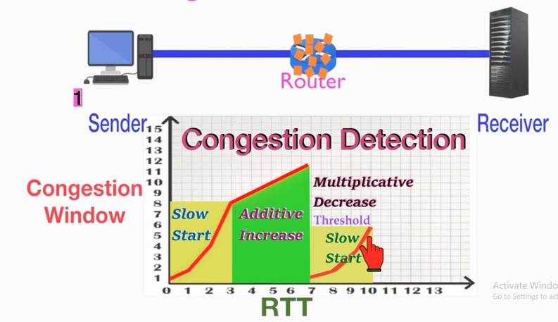
Phase 3: Congestion Detection

